Slide 1
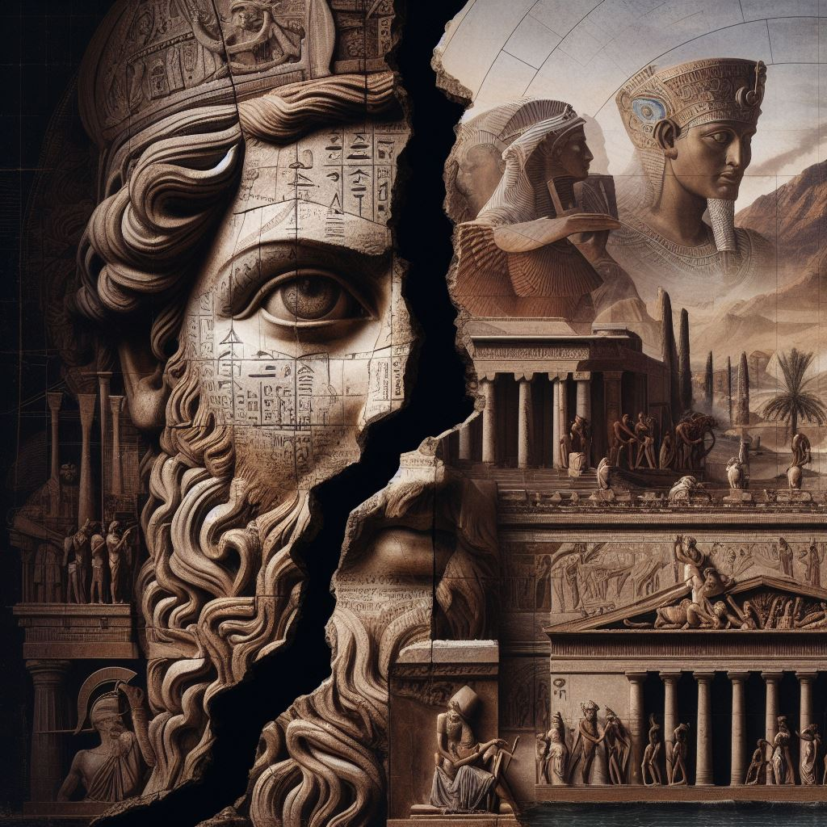
Power and Authority
GOAL/S: Identify key people
Describe power and authority in Ancient Rome
Week 1, Lesson 2

Slide 2

“Power tends to corrupt and absolute power corrupts absolutely.”
Dalberg acton, J., 1st Baron acton, april 5 1887, Letter to Bishop Creighton

Slide 3
Today’s Lesson
Key Individuals/Groups
Power and Authority in Rome

Slide 4
When Rome expelled their last king in 509 BCE, a republic was established with the intention that it should represent all of the people within Rome through a system of assemblies and magistracies. However, as Rome grew in power and controlled more of the regions around the Mediterranean, the system failed to adapt and change with this growth. Consequently, a large social, political and economic disparity emerged between the two main social classes – the patricians and plebeians. Beginning in the middle of the second century BCE, a succession of individuals began to expose the flaws in the system as they sought power for themselves, rather than using it for the public good. This resulted in 100 years of civil war between various powerful generals and the aristocratic Senate. Arguably, the Republic collapsed due to the combination of actions of key individuals and the socio-political climate at the time.

Slide 5
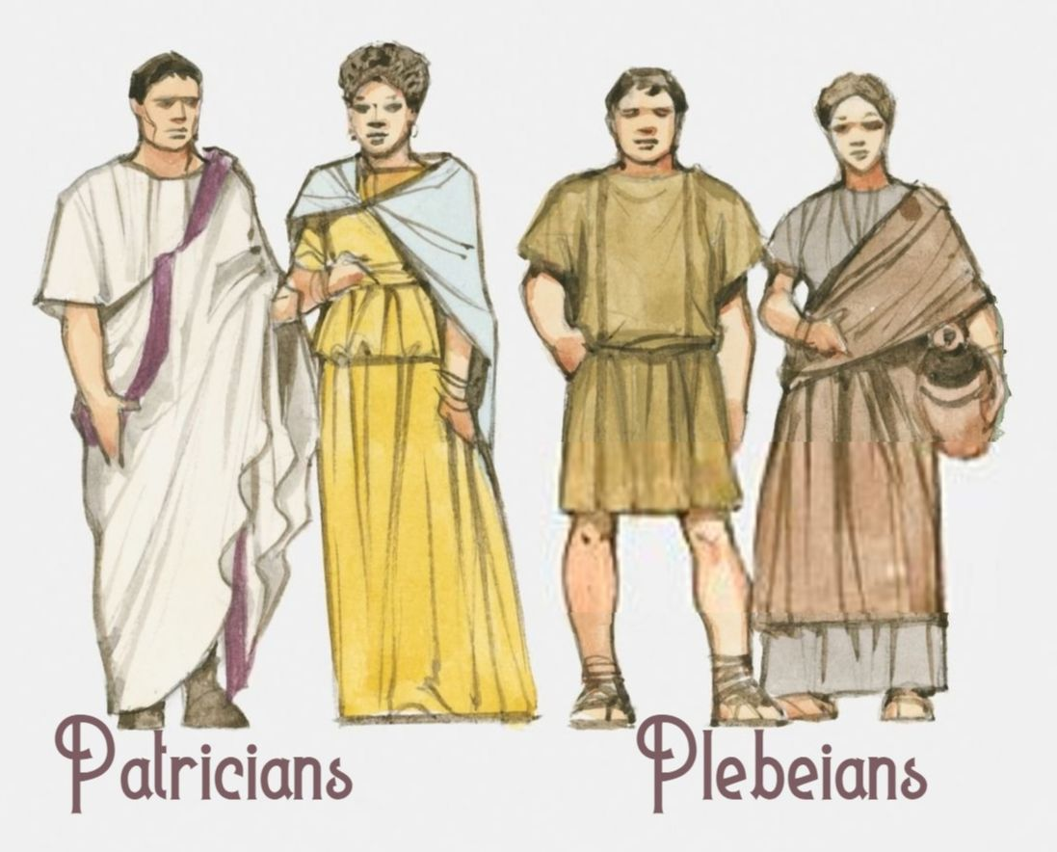
Patrician
DEFINITION:
wealthy social class; small group of privileged elite who came from old aristocratic families
(Aristocratic - the highest class in certain societies, typically comprising people of noble birth holding hereditary titles and offices)
SYNONYMS: aristocrat, noble, lord/lady

Slide 6
Plebeians
DEFINITION:
lower social class; the majority of Rome’s population
SYNONYMS: proletariat, working class, lower ranks

Slide 7
Classical history features many stories of the strong and powerful. In a time when military prowess was a key means of getting further in life, having power and authority enabled individuals to achieve fame and glory. In the decline of the Roman Republic, it is important to distinguish between power and authority. German sociologist Max Weber defined power as the ability to exercise one’s will over others, and authority as power that is accepted by others who agree to follow it. He argued there were three types of authority: 1. charismatic (deriving from strength of personality) 2. bureaucratic (given to a person by the law) 3. traditional (from established customs, such as inherited positions).

Slide 8
As you explore the complex reasons behind the collapse of the Republic, you will see that investing power or authority in the hands of individuals, rather than keeping the balance between all elements of the system, had serious repercussions. The people of the Republic did not realise this lesson and it eventually led to the downfall of the Republic itself. The powerful individuals in this unit all had some combination of authority and power.

Slide 9
DISCUSSION QUESTION
Which leaders do you already know of?
What types of authority did leaders have?

Slide 10
WORKSHEET – Key People
Glue the worksheet in your book OR put it in your folder
1
Read through the key individuals we will study this term
2
Highlight key information
3

Slide 11
Key Words – Power and Authority
398
Those in the highest positions were vested with imperium and were recognised by the auctoritas (authority) that they held.
This prestige filtered through to the holder’s family – descendants of consuls were called nobiles. The elevation in social status of an entire family assisted in the development of a social elite.
Voters often preferred nobiles because of the respect and prestige conferred on the family.
This meant that elections were more about an individual’s family connections rather than the individual themselves.
Thus the creation of a public image through carefully orchestrated friendships and marriages became key to political success.
The expectation of success was so high that should a son fail to achieve similar levels of prestige as his ancestors, it would be akin to bringing shame upon the family.
This disparity between families, and eventually social classes, contributed to the collapse of the Republic.

Slide 12

Other Key Groups
INSTRUCTIONS:
Read through the following slides about key groups
Create a mind-map about key groups - features

Slide 13
Non-Citizens
Foreigners
free men born outside city
not considered full citizens until law changes 212CE
could not vote until held citizenship
Slaves
not citizens, no rights
freed – given limited form of Roman citizenship and sons could be citizens
called freedmen or liberti
less fortunate – gladiators, labour

Slide 14
Women
technically citizens but few rights
most information was written by men
raise children/run household
Punic Wars changed the lives of women
Men away fighting
Widows received large sums of money – boosted self-reliance
2BCE – conditions changed
Conditions for marriage changed – more financial advantage and social freedom
Attended dinner parties, gladiator rights, chariot races, festivals

Slide 15
“If you give women equal freedom with men, do you think it will make them easier to live with? Far from it! If women have equality, they will become men’s masters.”
Translated extract from the writing of livy, a roman historian (59BCE to 17CE)

Slide 16
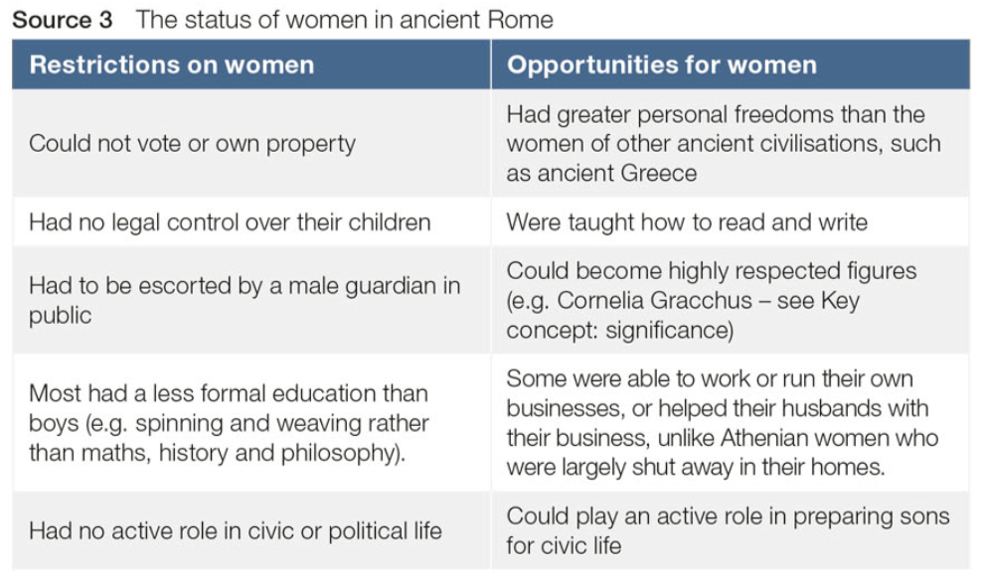

Slide 17
SUMMARY
Draw an image representing each new key word you have learned today
- Patrician
- Plebian
- Imperium
- Auctoritas
- Nobiles
- Liberti

